Slide 1
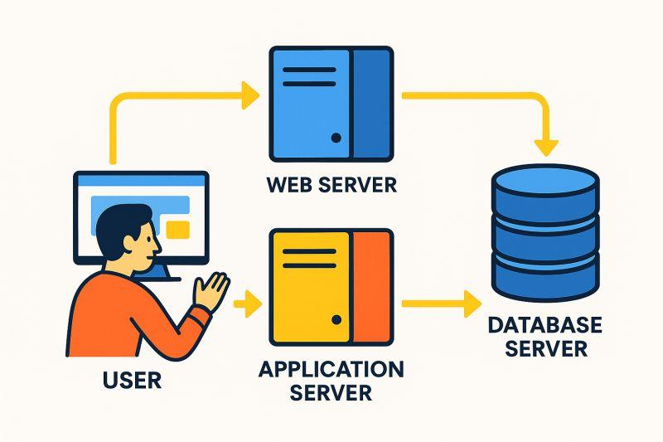
Server Roles, Change Management & Patch Management

Slide 2
What is a Server Role?
Server Role = Primary Function of a Server
Defines what a server does within a network
Provides a specific service to users, computers, or applications
Improves performance, security, manageability, and reliability
Examples: Web Server, File Server, Database Server, Directory Services Server

Slide 3
Common Server Roles
Web Server – Hosts websites and web applications
Application Server – Runs business applications
Directory Services Server – Manages users, computers, groups, and policies
Database Server – Stores and processes data
File Server – Provides centralized file storage
Print Server – Manages network printers
Messaging Server – Provides enterprise messaging services
Mail Server – Provides email services
RRAS Server – Provides routing and remote access
Network Services Server – Provides DNS, DHCP, NTP, and other network services

Slide 4
Web Server
Hosts and delivers websites and web applications
Supports static content such as HTML, images, CSS, and JavaScript
Can deliver dynamic content generated by web applications
Common uses: corporate websites, e-commerce, intranet portals, web applications
Administration focus: security, updates, HTTPS, access control, and performance
Typical flow: User → Browser → HTTP/HTTPS Request → Web Server → Response

Slide 5
Web Server Software
SERVER ROLES · WEB SERVER
Definition
A web server hosts websites and web applications and delivers them to clients over HTTP/HTTPS.
Microsoft IIS
Windows web hosting
Apache HTTP Server
Widely used open-source web server
Nginx
High-performance reverse proxy and web server
Key point: Name any two of the three — for example IIS and Apache.
Note: A web server hosts websites and web apps and delivers them over HTTP/HTTPS; common software: Microsoft IIS, Apache HTTP Server, Nginx.

Slide 6
Application Server
Hosts and executes business or enterprise applications
Processes business logic, calculations, transactions, and application sessions
Communicates with database servers to retrieve or store information
Examples: banking systems, CRM, HR systems, inventory systems
Separating application processing improves management and scalability
Typical architecture: Client → Web Server → Application Server → Database Server

Slide 7
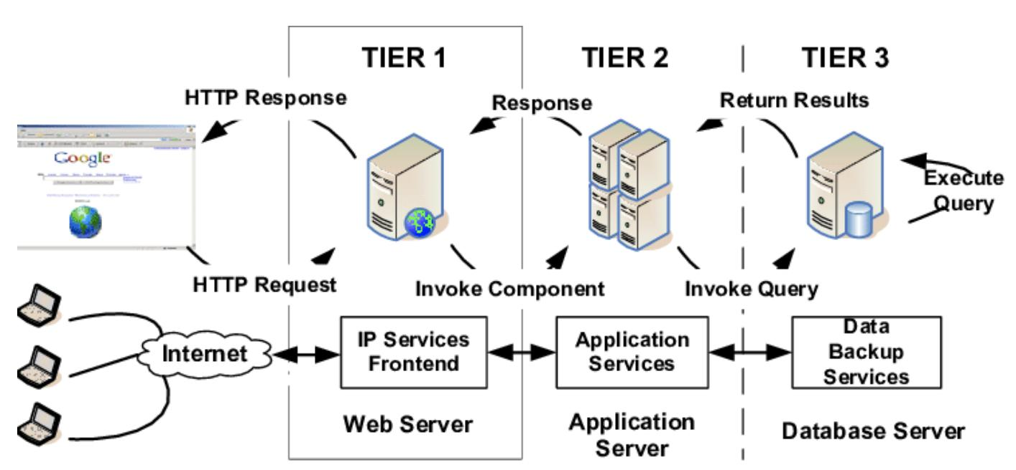

Slide 8
Directory Services Server
Provides centralized management of identities and network resources
Manages users, computers, groups, authentication, permissions, and security policies
Allows centralized administration instead of maintaining separate accounts on every computer
Simplifies administration and improves security
Helps apply organizational policies consistently
Detailed concepts such as domains and centralized authentication can be covered separately

Slide 9
Domain Controller
SERVER ROLES · DIRECTORY SERVICES SERVER
Definition
A domain controller is a directory services server that authenticates and authorises users and computers and applies central policy.
Authenticates
Verifies users and computers when they sign in
Authorises
Grants access based on directory accounts and groups
Enforces policy
Applies security and configuration policies (e.g. Group Policy in Active Directory)
Central identity store
Accounts are not managed on every machine
Remember: Domain controller = authentication + authorisation + policy enforcement from one central directory.

Slide 10
Database Server
Stores, manages, and processes structured data
Applications use it to retrieve, insert, update, and delete records
Processes transactions and supports multiple users
Examples of stored data: customers, products, orders, payments
Key requirements: performance, data integrity, reliability, backup, and security

Slide 11
File Server
Provides centralized storage for files and folders
Allows authorized users to access shared resources
Benefits: centralized storage, collaboration, access control, and easier backup
Administrators can assign permissions to users and groups
Typical flow: Users → File Server → Shared Folders

Slide 12

Print Server
Centrally manages one or more network printers
Receives print jobs and places them in queues
Sends queued jobs to the appropriate printer
Provides printer sharing, access control, monitoring, and queue management
Benefits: centralized administration and better printer utilization
Typical flow: User → Print Server → Print Queue → Printer

Slide 13

Messaging Server vs Mail Server
Messaging Server – Broader electronic communication and collaboration services
Messaging Server may support notifications, real-time messaging, and application messaging
Mail Server – Specifically manages email communication
Mail Server handles sending, receiving, storage, and mailbox management
Simple distinction: Mail Server = Email; Messaging Server = Broader communication

Slide 14
Mail Server
Sends, receives, stores, and delivers email messages
Manages user mailboxes and message storage
Handles communication between different email systems
May provide authentication, spam filtering, and email security
Typical outgoing flow: User → Mail Server → Destination Mail Server → Recipient
Typical incoming flow: Internet → Mail Server → User Mailbox

Slide 15
Mail Server Protocols
SERVER ROLES · MAIL SERVER
Protocol | Role
SMTP | Sends and relays email between servers
IMAP | Retrieves mail; keeps messages on the server (multi-device)
POP3 | Downloads mail primarily to one client
Sender client
→ SMTP
Mail server
→ IMAP / POP3
Recipient client
Teaching line: Mail servers use SMTP for sending; clients retrieve with IMAP or POP3.
Note: Two protocols: SMTP (send/relay) and IMAP or POP3 (retrieve).

Slide 16
Messaging vs Mail Server: Impact
SERVER ROLES · MESSAGING SERVER VS MAIL SERVER
Reliability
A dedicated mail path (SMTP/IMAP) plus broader messaging reduces single-channel failure for communication.
Security
Mail needs authentication, spam filtering and access control; messaging platforms need equivalent controls for chat and notifications.
User productivity
Reliable email and messaging keep collaboration and business processes moving; an outage blocks users immediately.
Simple distinction: Mail Server = email; Messaging Server = broader communication. Enterprise communication needs both to be reliable and secure.

Slide 17
RRAS Server
RRAS = Routing and Remote Access Service
Provides network routing between different networks
Provides remote access to authorized users
Common uses: remote employees, branch offices, and mobile users
Administrators configure routing, secure communication, and access control
Routing example: Network A → RRAS → Network B
Remote access example: Remote User → Secure Connection → RRAS → Internal Network

Slide 18
RRAS Services: Routing, VPN and NAT
SERVER ROLES · RRAS SERVER
Routing
Forwards traffic between different networks (Network A → RRAS → Network B).
VPN
Secure encrypted tunnel for remote users or branch sites into the internal network.
NAT
Translates private internal addresses to public addresses (and back) so internal hosts reach external networks without exposing every private IP.
Note: RRAS provides routing, remote access via VPN, and NAT.

Slide 19
Network Services Server
Provides essential services required for network operation
DNS – Name resolution
DHCP – IP address allocation
NTP – Time synchronization
Network management – Monitoring and administration
These services simplify communication and network administration

Slide 20
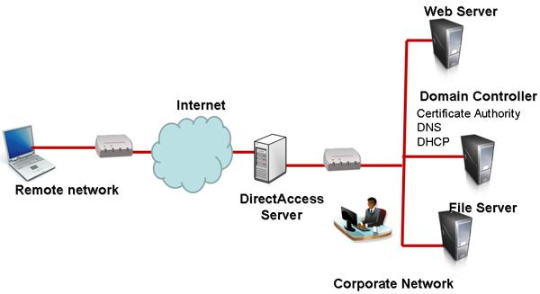

Slide 21
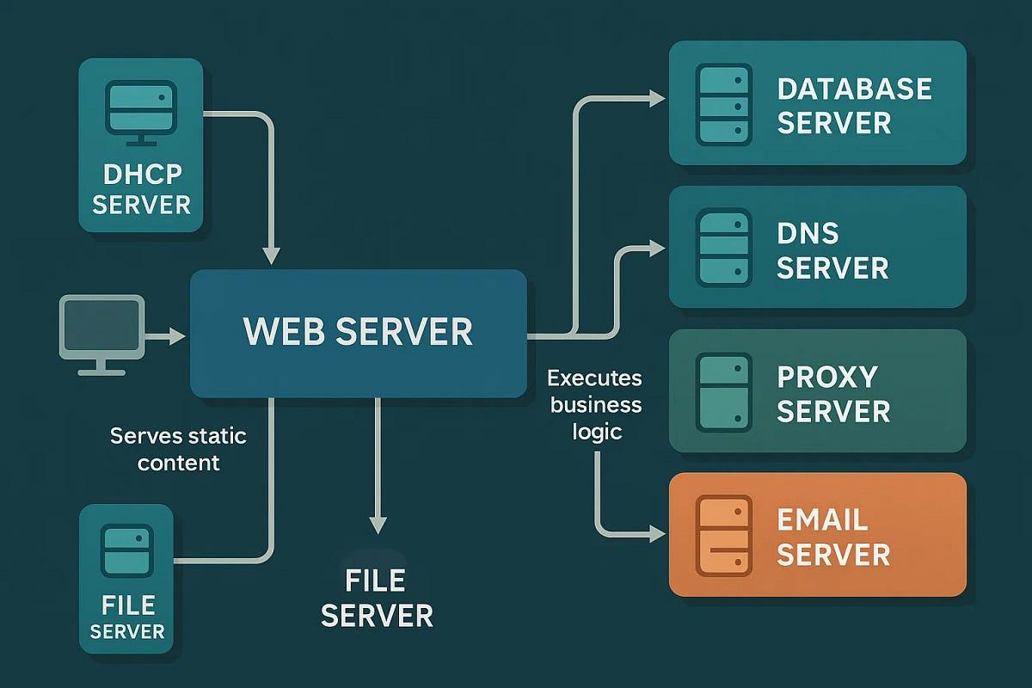

Slide 22
Why Change Management?
Servers continuously require changes
Examples: software updates, hardware upgrades, network changes, new applications, and security improvements
Uncontrolled changes can cause errors, service failures, downtime, and business impact
Change Management provides a controlled process
Core flow: Plan → Approve → Implement → Verify → Document

Slide 23
Types of Changes
Standard Change – Routine, low-risk, pre-approved change using an established procedure
Normal Change – Planned modification requiring evaluation, approval, and scheduling
Emergency Change – Urgent modification required to resolve a critical issue
Standard example: routine antivirus update
Normal example: server migration or network configuration change
Emergency example: critical security fix during an active incident

Slide 24
Change Management Process
Step 1
Identify the Need for Change
Step 2
Assess Impact and Risks
Step 3
Plan the Change
Step 4
Obtain Approval
Step 5
Implement the Change
Step 6
Verify the Results
Step 7
Document and Review

Slide 25
Step 1 – Identify the Need for Change
Determine why the change is necessary
Define the problem or requirement
Identify the expected outcome
Common reasons: security improvement, hardware upgrade, software update, performance optimization, and business requirements

Slide 26
Step 2 – Assess Impact and Risks
Determine how the change may affect servers, applications, users, and network services
Ask whether downtime is required
Check whether applications could be affected
Identify compatibility concerns
Determine what could happen if the change fails
Use the assessment to prepare precautions and recovery measures

Slide 27
Step 3 – Plan the Change
Define the tasks to be performed
Assign responsible personnel
Choose a maintenance window
Prepare required backups
Document implementation steps
Prepare a rollback procedure

Slide 28
Maintenance Window
CHANGE MANAGEMENT · PLAN THE CHANGE
Definition
A pre-agreed, scheduled time period during which changes, patches or maintenance may be performed, often with expected limited downtime, chosen to minimise business impact.
In change management
Step 3 chooses the window; Step 5 implements the change within it.
In patch management
Step 4 schedules deployment in a window so stakeholders know when disruption may occur.
Remember: The window tells stakeholders when disruption may occur and keeps risky work out of business hours.

Slide 29
Step 4 – Obtain Approval
Obtain approval before implementing changes that may affect production systems
Review the change from technical and business perspectives
Prevent unauthorized modifications
Ensure stakeholders understand the expected impact and timing

Slide 30
Step 5 – Implement the Change
Perform the planned modification during the scheduled maintenance window
Follow the documented implementation procedure
Monitor the server during implementation
Identify unexpected issues immediately
Use the rollback procedure if the change cannot be completed safely

Slide 31
Step 6 – Verify the Results
Confirm that the intended change was successfully applied
Verify that all required services are functioning
Check for unexpected errors
Test critical applications
Confirm that users can access required resources

Slide 32
Step 7 – Document and Review
Record the date and time
Record the change description
Record personnel involved
Document issues encountered
Record the final outcome
Add recommendations for future changes
Documentation supports troubleshooting, auditing, and future maintenance

Slide 33
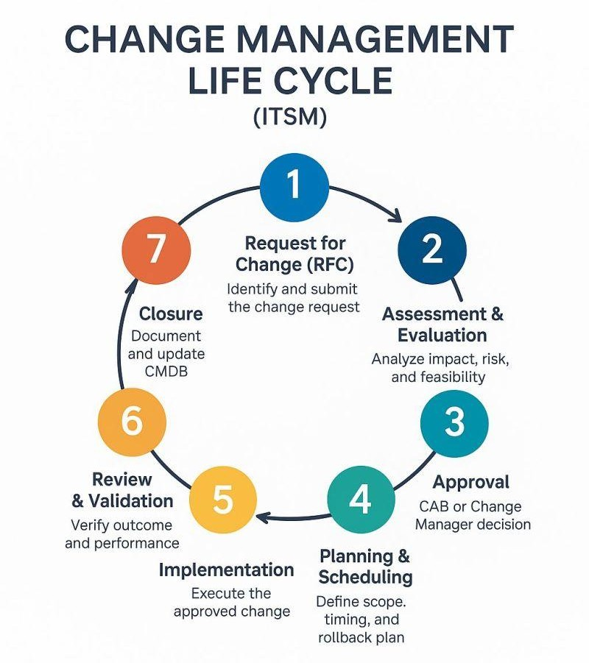

Slide 34
What is a Patch?
A patch is a software update released to modify or correct existing software
Patches can fix vulnerabilities, bugs, performance problems, and compatibility issues
Patch management is more than simply installing updates
Administrators must identify, evaluate, test, deploy, verify, and document patches

Slide 35
Types of Patches
Security Patch – Corrects vulnerabilities that attackers could exploit
Bug Fix Patch – Resolves software defects and unexpected behavior
Performance Patch – Improves efficiency and resource utilization
Compatibility Patch – Improves compatibility with hardware, software, drivers, or technologies

Slide 36
Hotfix vs Service Pack
PATCH MANAGEMENT · TYPES OF PATCHES
Aspect | Hotfix | Service pack
Scope | Small, targeted fix for a specific issue | Large cumulative package of many fixes
Urgency | Often urgent (especially security) | Planned, broader release
Testing | Limited, focused | Broader regression testing
Deployment | Applied when the specific problem is present | Deployed as a major maintenance update
Example | Emergency security fix for one vulnerability | SP that rolls up months of patches
Note: A hotfix is narrow and urgent; a service pack is cumulative and scheduled.

Slide 37
Patch Priority
Critical security patches generally receive the highest priority
Priority depends on severity, exploitability, business impact, and affected systems
Critical Security Patch – Highest urgency
High-Risk Security Patch – High urgency
Important Bug Fix – Moderate urgency
Performance or Compatibility Update – Priority depends on business need

Slide 38
Patch Management Process
Step 1
Identify Available Patches
Step 2
Evaluate the Patch
Step 3
Test the Patch
Step 4
Schedule Deployment
Step 5
Install the Patch
Step 6
Verify Successful Installation
Step 7
Document the Update

Slide 39
Step 1 – Identify Available Patches
Review vendor notifications
Check update repositories
Use centralized patch management systems
Identify patches for operating systems, applications, and supported software
Determine the purpose, severity, and affected systems

Slide 40
Step 2 – Evaluate the Patch
Review vendor release notes
Identify issues addressed by the patch
Check affected systems and software versions
Look for compatibility concerns
Determine whether a restart is required
Prioritize patches based on risk and business impact

Slide 41
Step 3 – Test the Patch
Test patches in a controlled environment whenever practical
Verify application compatibility
Verify server roles and services
Check dependencies and performance
Look for unexpected errors
Goal: find problems before production users are affected

Slide 42
Step 4 – Schedule Deployment
Deploy during an appropriate maintenance window
Consider server usage and expected downtime
Check restart requirements
Consider business impact
Ensure recent backups are available
Prepare a rollback or recovery plan

Slide 43
Step 5 – Install the Patch
Use the operating system update mechanism or centralized patch management solution
Monitor the installation process
Check for installation errors
Perform required system restarts
Monitor server health after installation

Slide 44
Step 6 – Verify the Patch
Confirm the correct software or patch version
Verify that server services restarted successfully
Check system logs for update-related errors
Test critical applications and services
Confirm users can access required resources
Patch installed does not automatically mean patch successfully verified

Slide 45
Step 7 – Document the Update
Record patch identification or version
Record installation date
Record affected servers
Record administrator responsible
Document issues encountered
Record verification results
Documentation supports troubleshooting, auditing, compliance, and future maintenance

Slide 46
Patch Management at Large Scale:
PATCH MANAGEMENT · ANALYSE
1. Inventory and classify servers (OS, role, criticality)
2. Identify and evaluate patches centrally
3. Test in a lab or pilot group first
4. Deploy in rings: pilot → non-critical → critical
5. Verify and document per group
6. Use centralised patch tools for consistency
Risk of delaying patches
Longer exposure to known exploits
SLA and compliance risk
Risk of rushing patches
Untested updates can break roles/apps
Mass outage across 200 servers; difficult rollback
A pilot group is a small, representative subset of endpoints used to test and validate software patches before they are deployed organization-wide.
Note: Controlled rings plus testing balance security urgency with stability.

Slide 47
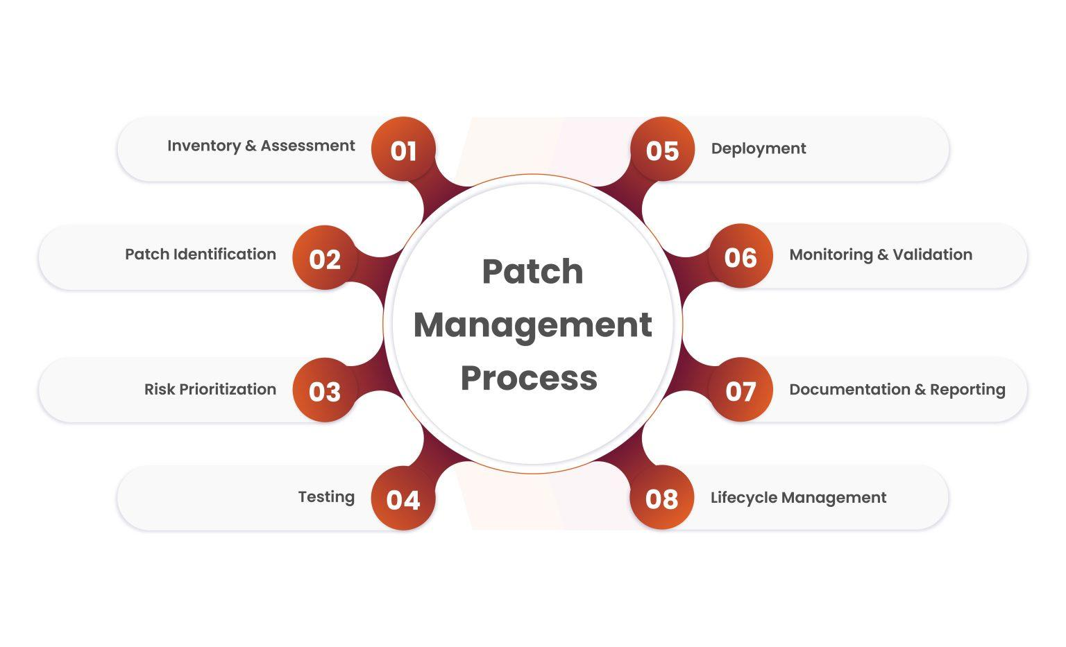

Slide 48
Change Management vs Patch Management
Change Management – Controls and governs many types of modifications
Patch Management – Specifically manages software and security updates
Change examples: hardware changes, network changes, application migration, configuration changes
Patch examples: security patches, bug fixes, performance updates, compatibility updates

